Slide 1
Vehicle Monitoring System
Advisor : 陳朝烈
Member : 葉日勝 黃柏儒 黃少鏞 楊豐瑞

Slide 2
OUTLINE
Functional Analysis
Dataflow Analysis
活動Analysis
1
2
3

Slide 3
1
Functional Analysis
Driver:
Can watch 3 directions of images through screen, and upload to Cloud
MCU will receive manager’s warning for bad driving behavior
Cloud:
Receive 3 images and stitch
resource allocation properly
Manager、Supervisor:
Display panorama on UI, and monitor driver’s behavior
Send down the waring instruction
MQTT
M
UDP
UDP
UI
CAMERA
MCU
RASPBERRY

Slide 4
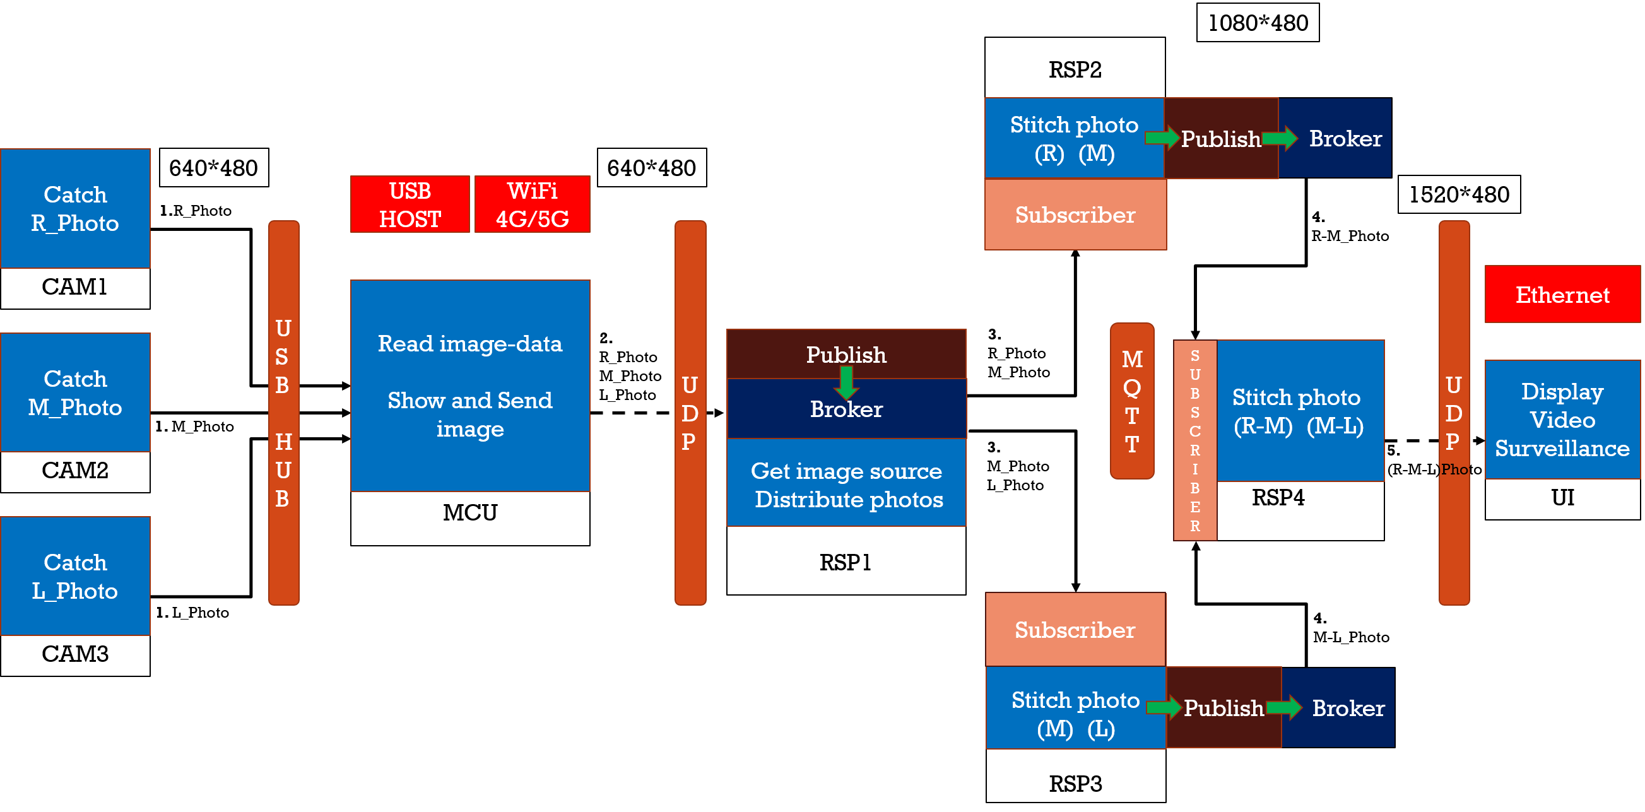
2
Dataflow Analysis

Slide 5
2
Dataflow Analysis
M
R
L
M
L
M
R
L
M
R
L
M
R
L
M
R
R
L
M

Slide 6
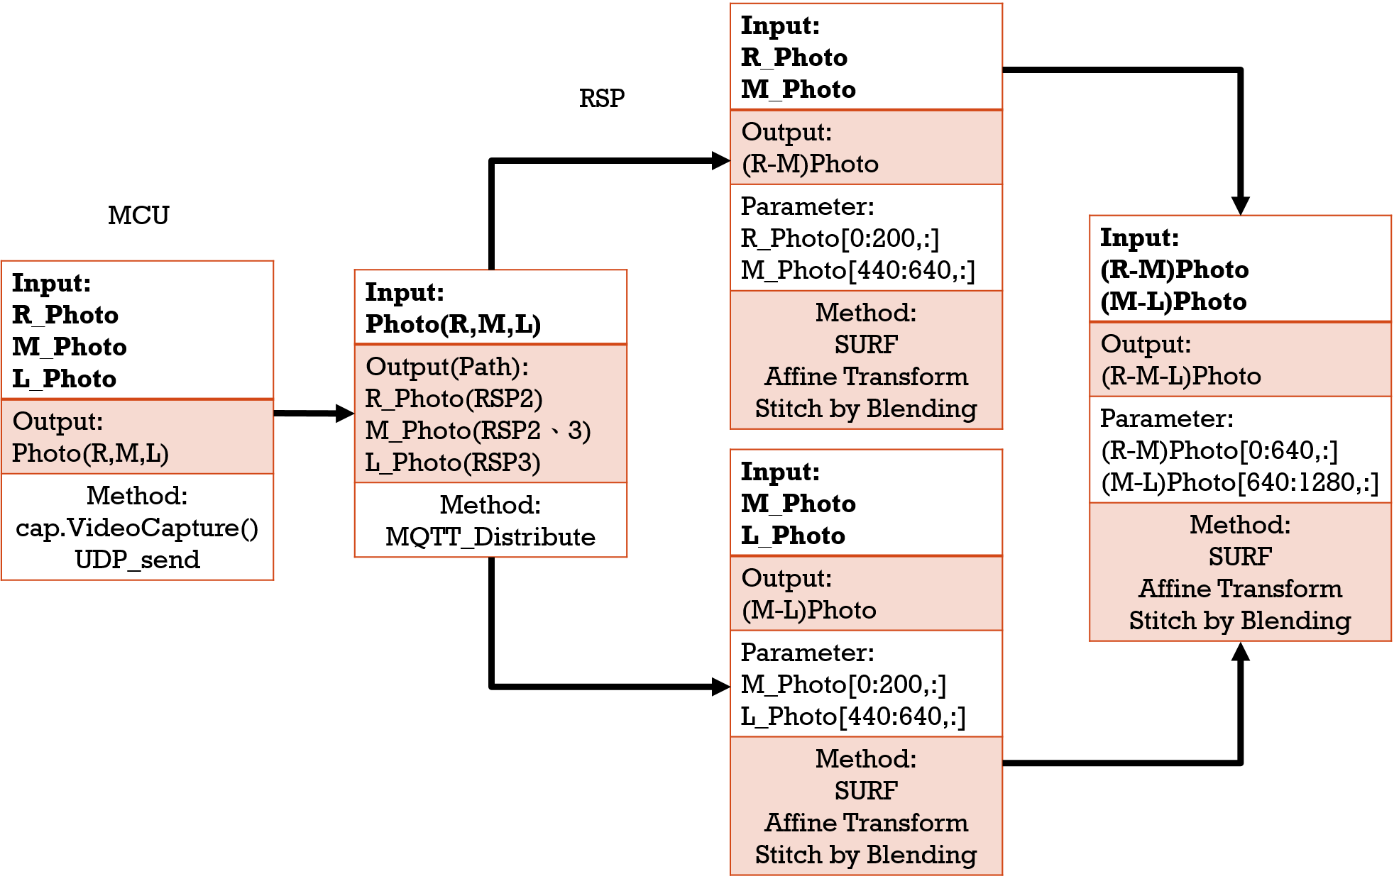
2
Dataflow Analysis

Slide 7
2
Code Analysis
Notes:
1.Save 3 images simultaneously, and output images to Cloud by UDP(4G)
2.VGA display 3 input’s images (by USB)

Slide 8
2
Code Analysis

Slide 9

Udp(monitored)
Udp(monitoring)
INPUT
INPUT
METHOD
L_Photo
Use socket build Ethernet for strengthen deliver’s instantaneity,
and use UDP to transmission
M_Photo
(L-M-R)Photo
R_Photo

Slide 10
mcu
INPUT
OUTPUT
PARAMETER
METHOD
L_Photo
Image[3]
Input 3 image by USB, save in array, send by UDP(4G)
{L_Photo,
M_Photo,
R_Photo}
Null
M_Photo
R_Photo

Slide 11
Rsp1 (Distribute photo)
OUTPUT
To RSP2
INPUT
M_Photo,
R_Photo
PARAMETER
METHOD
Image[3]
Topic
(MQTT Topic)
Read Image[];
{L_Photo,
M_Photo,
R_Photo}
Send Image(image[],Topic);
OUTPUT
Image[]
(Image Content)
//Send to the specified Rasperry Pi by MQTT
To RSP3
L_Photo,
M_Photo

Slide 12
Rsp2 (Stitch photo)
INPUT
OUTPUT
PARAMETER
METHOD
Topic
(MQTT Topic)
KeyPoints Detector – data array
Feature Extraction – data array
Feature Matching - image
Affine - image
Stitch - image
M_Photo
M-R_Photo
R_Photo
Image[]
(Image Content)

Slide 13
Rsp3 (Stitch photo)
INPUT
OUTPUT
PARAMETER
METHOD
Topic
(MQTT Topic)
KeyPoints Detector – data array
Feature Extraction – data array
Feature Matching - image
Affine - image
Stitch - image
L_Photo
L-M_Photo
M_Photo
Image[]
(Image Content)

Slide 14
Rsp4 (Stitch photo)
INPUT
OUTPUT
PARAMETER
METHOD
M-R_Photo
KeyPoints Detector – data array
Feature Extraction – data array
Feature Matching - image
Stitch - image
L-M-R_Photo
Null
L-M_Photo

Slide 15
MQTT
INPUT
OUTPUT
PARAMETER
METHOD
Topic 1 : M_Photo, R_Photo
Topic 1 : M_Photo, R_Photo
To reduce communication loss, use QOS2 to build
Topic 2: L_Photo, M_Photo
Topic 2: L_Photo, M_Photo
Topic
Topic 3 : M-R_Photo
Topic 3 : M-R_Photo
Topic 4 : L-M_Photo
Topic 4 : L-M_Photo

Slide 16
ui
INPUT
OUTPUT
PARAMETER
METHOD
UDP receive data, display interface through C# Form, use VGA or HDMI to display screen
Display Image
(VGA or HDMI)
Null
L-M-R_Photo

Slide 17
1080*480
RSP2
Stitch photo
(R) (M)
Publish
Broker
CAM1
640*480
640*480
Catch
R_Photo
USB
HOST
WiFi
4G/5G
Subscriber
1520*480
1.R_Photo
4.
M-R_Photo
USB
HUB
UDP
UDP
Ethernet
MCU
Read image-data
Show and Send image
2.
R_Photo
M_Photo
L_Photo
Publish
3.
R_Photo
M_Photo
MQTT
RSP1
CAM2
Get image source
Distribute photos
Catch
M_Photo
RSP4
Stitch photo
(R-M) (M-L)
S
U
B
S
C
R
I
B
E
R
UI
Display
Video
Surveillance
Broker
1. M_Photo
3.
M_Photo
L_Photo
5.
(L-M-R)Photo
CAM3
Catch
L_Photo
Subscriber
RSP3
1. L_Photo
Stitch photo
(M) (L)
4.
L-M_Photo
Publish
Broker

Slide 18
Input: R_Photo M_Photo
Output: (R-M)Photo
Parameter: R_Photo[0:200,:] M_Photo[440:640,:]
Method: SURF Affine Transform Stitch by Blending
RSP
MCU
Input: (R-M)Photo (M-L)Photo
Output: (R-M-L)Photo
Parameter: (R-M)Photo[0:640,:] (M-L)Photo[640:1280,:]
Method: SURF Affine Transform Stitch by Blending
Input: R_Photo M_Photo L_Photo
Output: Photo(R,M,L)
Method: cap.VideoCapture() UDP_send
Input: Photo(R,M,L)
Output(Path): R_Photo(RSP2) M_Photo(RSP2、3) L_Photo(RSP3)
Method: MQTT_Distribute
Input: M_Photo L_Photo
Output: (M-L)Photo
Parameter: M_Photo[0:200,:] L_Photo[440:640,:]
Method: SURF Affine Transform Stitch by Blending

Slide 19
2
Dataflow Analysis
Step1:UDP收取車輛傳輸的3個角度照片(照片1 2 3)，並利用MQTT分送至3個node(node1 2 3)做分散式運算
Step2:node同步收取照片後找出keypoints
Step3:node2找出的keypoints丟至node1及node3
Step4:node1將照片1、2合併node3將照片2、3合併
Step5:做affine並丟回Master
Step6:合併node1及node2合併的照片變成一張廣角圖
Final：利用UDP丟至行控中心的UI段端進行監控

Slide 20
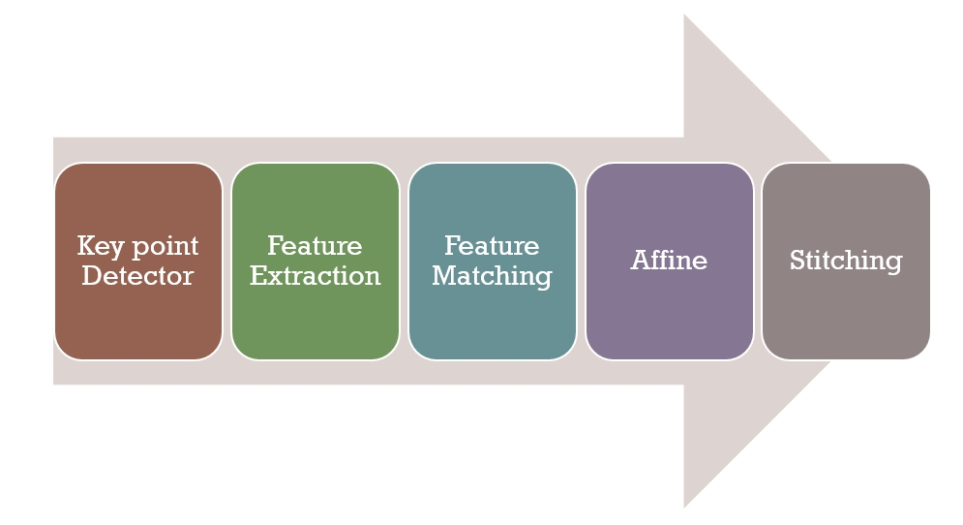
3
活動Analysis

